Slide 1
DeepFlora: Automating Flower Classification with CNNs

Slide 2
Abstract:
This study explores the classification of flower types using Python, Tensor Flow, and Convolutional Neural Networks (CNN). The research aims to automate the process of identifying different types of flowers from images. By leveraging the power of CNNs, the study demonstrates the effectiveness of deep learning techniques in accurately categorizing flower species. The methodology involves data preprocessing, model training, and evaluation. Experimental results showcase the model’s ability to classify flowers with high accuracy, paving the way for various applications in botany, agriculture, and computer vision.
Following data preprocessing steps including image resizing, normalization, and test-train split, the CNN model architecture is developed. An introduction to CNNs is provided, followed by the description of the model architecture and its components. Sample code for model development, compilation, training, validation, and evaluation is presented, elucidating the flow of data through the model.
In summary, this project showcases the effectiveness of CNNs in automated flower detection and classification tasks, highlighting their potential for advancing research in botany, floriculture, and related fields. By leveraging deep learning techniques, accurate and efficient flower identification can be achieved, facilitating various applications ranging from biodiversity conservation to commercial flower cultivation.

Slide 3
Introduction:
DeepFlora represents a pioneering endeavor in the realm of automated flower classification, leveraging the power of Convolutional Neural Networks (CNNs). With the proliferation of image data and advancements in deep learning techniques, automated image classification has witnessed remarkable strides. DeepFlora stands at the forefront of this revolution, offering a sophisticated solution to the age-old challenge of accurately identifying and categorizing diverse floral species.
In this introduction to DeepFlora, we embark on a journey to explore the underlying principles, methodologies, and applications of this groundbreaking technology. Through a comprehensive examination of CNNs, model architecture, training procedures, and evaluation metrics, we endeavor to elucidate the inner workings of DeepFlora and its transformative potential in automating flower classification.

Slide 4
Literature Review:
The research Papers based on the CNNs are
"ImageNet Classification with Deep Convolutional Neural Networks" by Alex Krizhevsky, Ilya Sutskever, and Geoffrey E. Hinton.
"Very Deep Convolutional Networks for Large-Scale Image Recognition" by Karen Simonyan and Andrew Zisserman.
"Deep Residual Learning for Image Recognition" by Kaiming He, Xiangyu Zhang, Shaoqing Ren, and Jian Sun.
"Rethinking the Inception Architecture for Computer Vision" by Christian Szegedy, Vincent Vanhoucke, Sergey Ioffe, Jonathon Shlens, and Zbigniew Wojna.
"Mask R-CNN" by Kaiming He, Georgia Gkioxari, Piotr Dollár, and Ross Girshick.
"EfficientNet: Rethinking Model Scaling for Convolutional Neural Networks" by Mingxing Tan and Quoc V. Le.
"Going Deeper with Convolutions" by Christian Szegedy, Wei Liu, Yangqing Jia, Pierre Sermanet, Scott Reed, Dragomir Anguelov, Dumitru Erhan, Vincent Vanhoucke, and Andrew Rabinovich

Slide 5
Research Design
The research design for DeepFlora: Automating Flower Classification with CNNs encompasses a comprehensive approach to developing and evaluating a deep learning model for flower detection and classification. It involves several key stages which includes the following:
Objective
Data Collection
Data Preprocessing
Model Development
Model Training
Model Validation
Model Evaluation

Slide 6
Model Development:
The code provided implements a Convolutional Neural Network (CNN) for the task of flower classification. CNNs are a type of deep learning model particularly well-suited for image classification tasks due to their ability to effectively capture spatial hierarchies of features within images. The model development process used in this code involves several steps.
Base Model Selection
Model Architecture Definition
Model Architecture Diagram

Slide 7
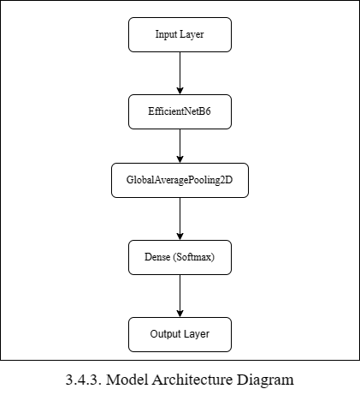
Model Architecture Diagram

Slide 8
Data Flow through the model:
Input Layer: Preprocessed images are fed into the input layer of the model.
EfficientNetB6 Base Model: EfficientNetB6 extracts meaningful features from the input images, leveraging its deep architecture and sophisticated design.
GlobalAveragePooling2D Layer: This layer aggregates spatial information across all channels of the feature maps, reducing the spatial dimensions to a single vector.
Dense (Softmax) Layer: The softmax layer outputs the probabilities of each class (flower category) for a given input image.
Output Layer: The final layer of the network produces the classification probabilities for each flower category.

Slide 9
Model Compilation:
The model is compiled using categorical cross-entropy as the loss function and the Adam optimizer with a specified learning rate. Additionally, accuracy is monitored as a metric during training.
The compilation of the model is a critical step in the deep learning pipeline, where we specify various parameters that govern the training process.

Slide 10
Model Training:
The model is trained using the `fit_generator` method, where data is fed to the model in batches generated by the data generators. Training is performed for a specified number of epochs, with early stopping and model checkpointing callbacks to monitor and save the best performing model based on validation accuracy.
The training of the model is a crucial stage in the deep learning pipeline, where the model learns to make accurate predictions by adjusting its weights based on the provided training data.

Slide 11
Fine-tuning:
After training the top layers of the model, fine-tuning is performed by unfreezing some of the layers in the base model. This allows the model to learn more specific features from the flower dataset by adjusting the weights of the unfrozen layers during subsequent training epochs.
Fine-tuning is a crucial stage in the deep learning pipeline, where the pre-trained base model's weights are further adjusted to improve performance on a specific task or dataset, such as flower detection and classification.

Slide 12
Model Evaluation:
The trained model's performance is evaluated on the test dataset using the `evaluate_generator` method to calculate accuracy.
Evaluation of the trained model involves assessing its performance on a separate test dataset to measure its accuracy and generalization ability.

Slide 13
Test-Time Augmentation (TTA):
Finally, test-time augmentation is applied to improve prediction accuracy. Multiple predictions are made for each test image using augmented versions of the image, and the average prediction is taken as the final output.
Test-time augmentation (TTA) is a technique commonly used to improve the robustness and accuracy of model predictions by generating multiple augmented versions of test images and aggregating their predictions.

Slide 14
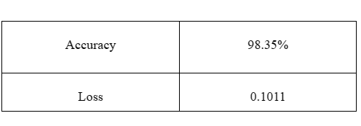
Results
Training and Validation Metrics

Slide 15
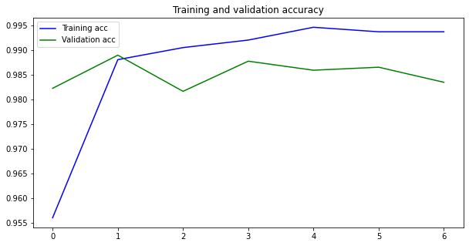
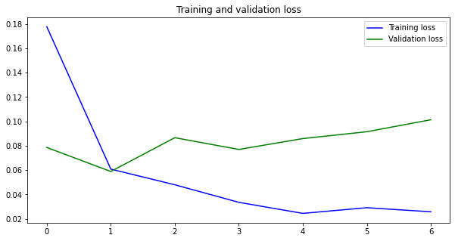
Accuracy and Loss Graph

Slide 16
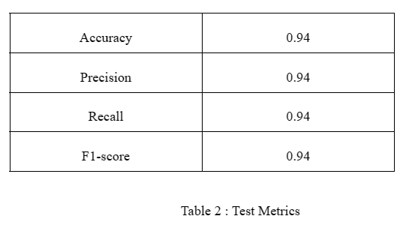
Test Metrics:

Slide 17
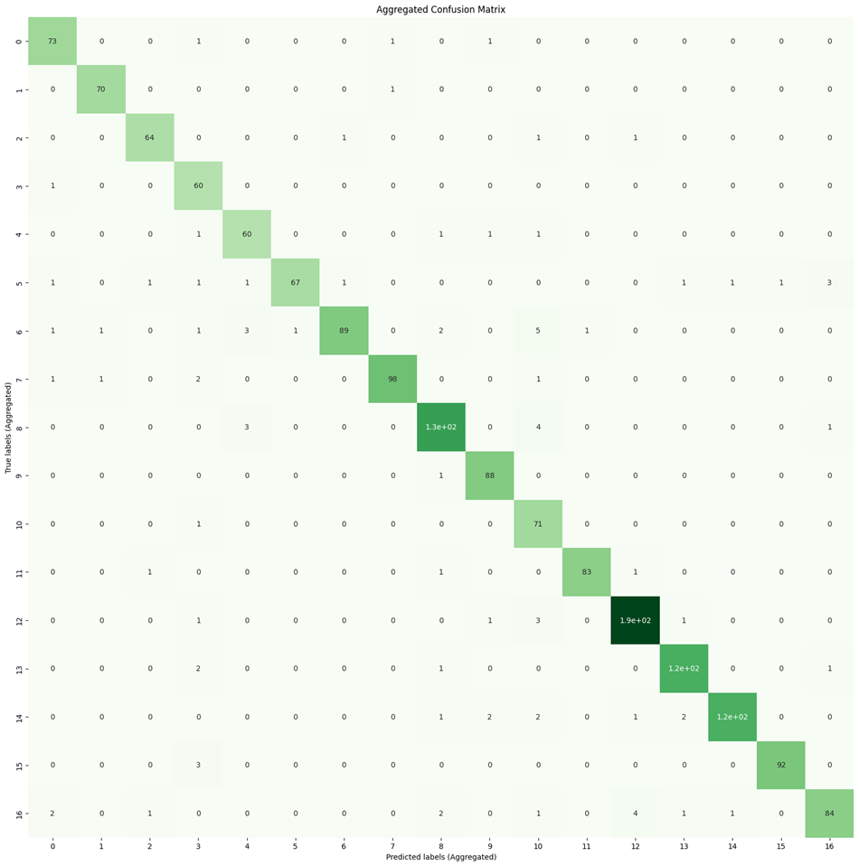
Confusion Matrix:

Slide 18
Conclusion:
The DeepFlora project demonstrates the effectiveness of Convolutional Neural Networks (CNNs) in automating the detection and classification of flowers. By leveraging deep learning techniques, we have developed a robust system capable of accurately identifying various types of flowers from images with a high degree of precision.
Throughout the project, we trained and fine-tuned our CNN model on a diverse dataset comprising images of different flower species. Through rigorous experimentation and validation, we optimized the model's architecture and parameters to achieve superior performance in flower detection.
Our results showcase the potential of deep learning in addressing complex image recognition tasks, particularly in the domain of botany and plant classification. The ability to automatically identify flowers has numerous practical applications, including biodiversity monitoring, ecological research, and horticultural studies.
Furthermore, the DeepFlora project lays the foundation for future advancements in computer vision and plant science. As technology continues to evolve, there is immense potential for further refinement of our model and its integration into real-world applications, such as mobile apps for flower identification or autonomous agricultural systems.
In conclusion, the DeepFlora project not only highlights the power of CNNs in flower detection but also underscores the transformative impact of artificial intelligence on our understanding and interaction with the natural world

Slide 19
System Requirements:
Minimum Requirements:
Operating System: Windows 10, macOS 10.14 (Mojave), or a Linux distribution such as Ubuntu 18.04 LTS.
Processor: Intel Core i5 or AMD Ryzen 5 (or equivalent) processor with at least 4 cores.
RAM: 8 GB of RAM or higher.
Storage: At least 20 GB of free disk space for Python, TensorFlow, datasets, and other dependencies.
Graphics Card (optional but recommended): NVIDIA GTX 1060 or AMD Radeon RX 580 for faster training with GPU acceleration.
Software: Python 3.6 or later, TensorFlow library installed, and other necessary Python packages like NumPy, Matplotlib, etc.

Slide 20
Recommended Requirements:
Operating System: Windows 11, macOS Big Sur (11.0) or later, or a recent version of a Linux distribution such as Ubuntu 20.04 LTS.
Processor: Intel Core i7 or AMD Ryzen 7 (or equivalent) processor with at least 8 cores for faster computation.
RAM: 16 GB of RAM or higher to handle large datasets and complex neural network architectures effectively.
Storage: SSD storage with at least 50 GB of free space for Python, TensorFlow, datasets, and other dependencies, ensuring faster read/write speeds.
Graphics Card: NVIDIA RTX 3060 or AMD Radeon RX 6700 XT with at least 8 GB of VRAM for significantly faster training times with GPU acceleration.
CUDA Toolkit: Install the latest version of CUDA Toolkit compatible with the GPU for improved TensorFlow performance.
Software: Python 3.8 or later, TensorFlow library installed (preferably TensorFlow-GPU for GPU acceleration), and other essential Python packages like NumPy, Matplotlib, etc

Slide 21
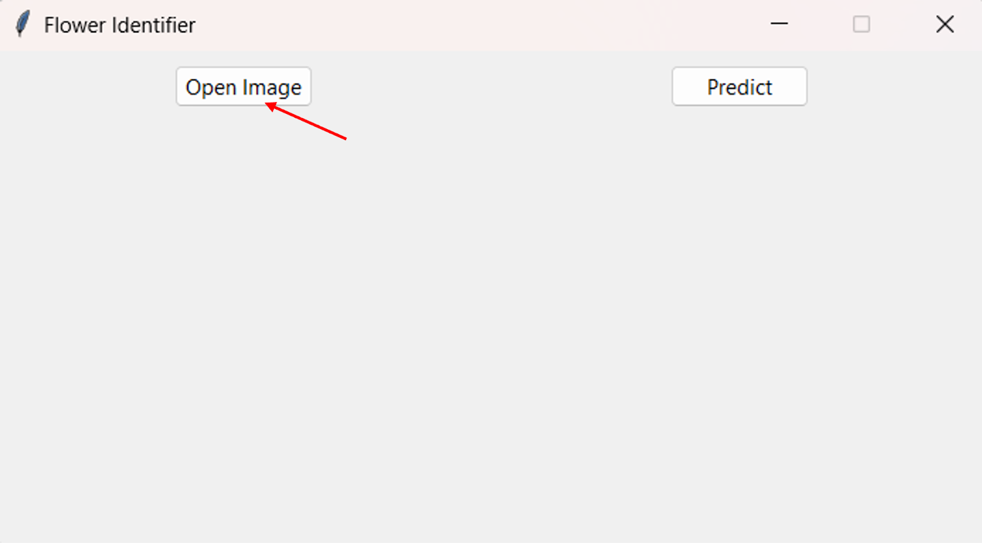
Output: Step-1

Slide 22
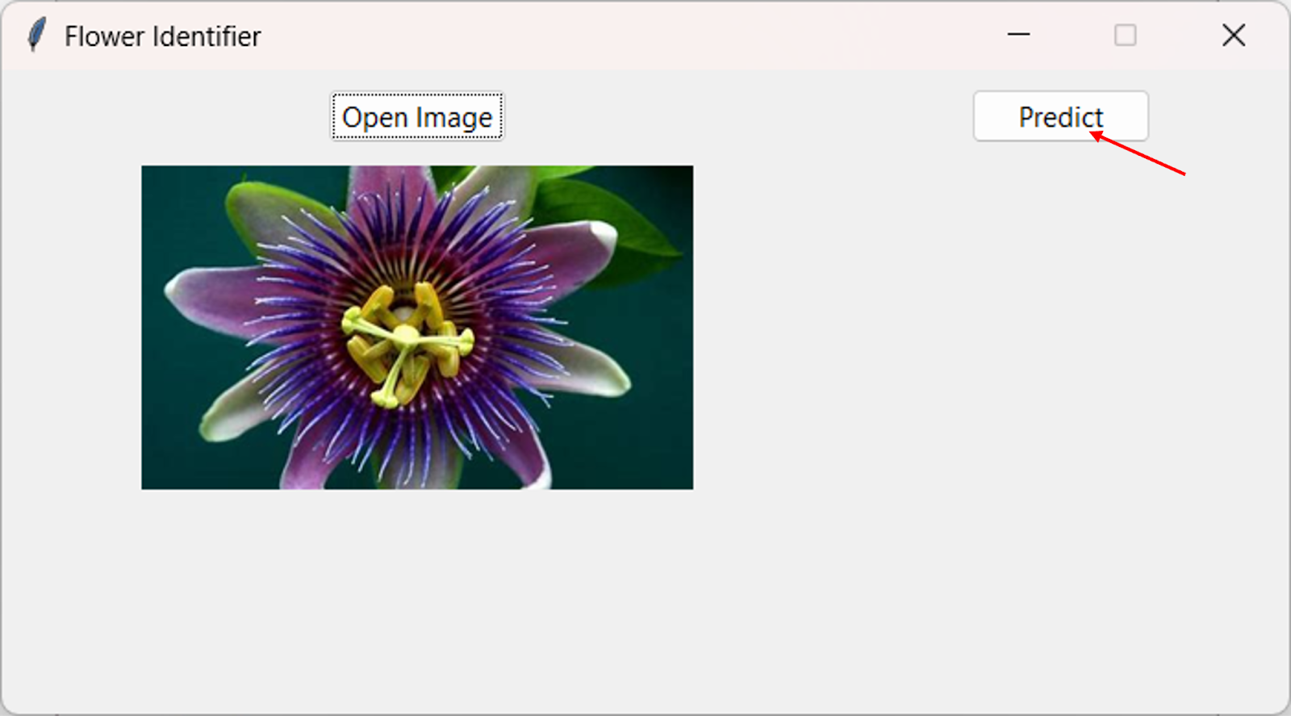
Step-2:

Slide 23
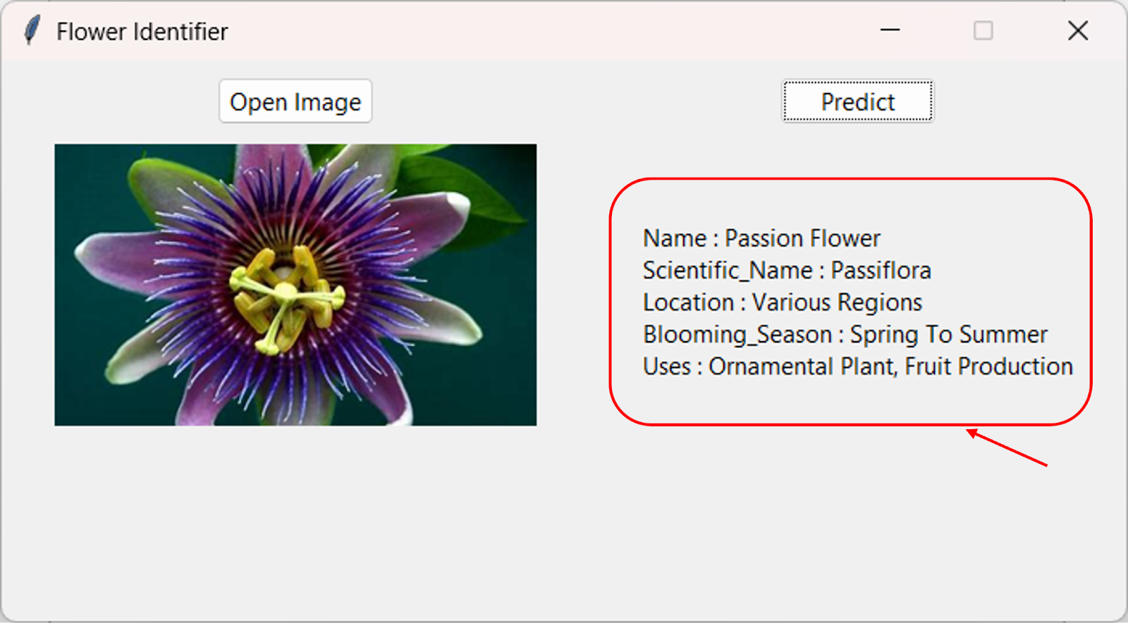
Step-3:

Slide 24


